Slide 1

Product Sales Analysis
Presented by,
A.kavipriya
j.l.manovathi
g.priyadharshini
b.sweatha

Slide 2
OBJECTIVES
1)DATA COLLECTION
2)DATA IMPORTING
3)DATA ANALYZING
4)DATA PREPROCESSING
5)DATA VISUALIZATION

Slide 3
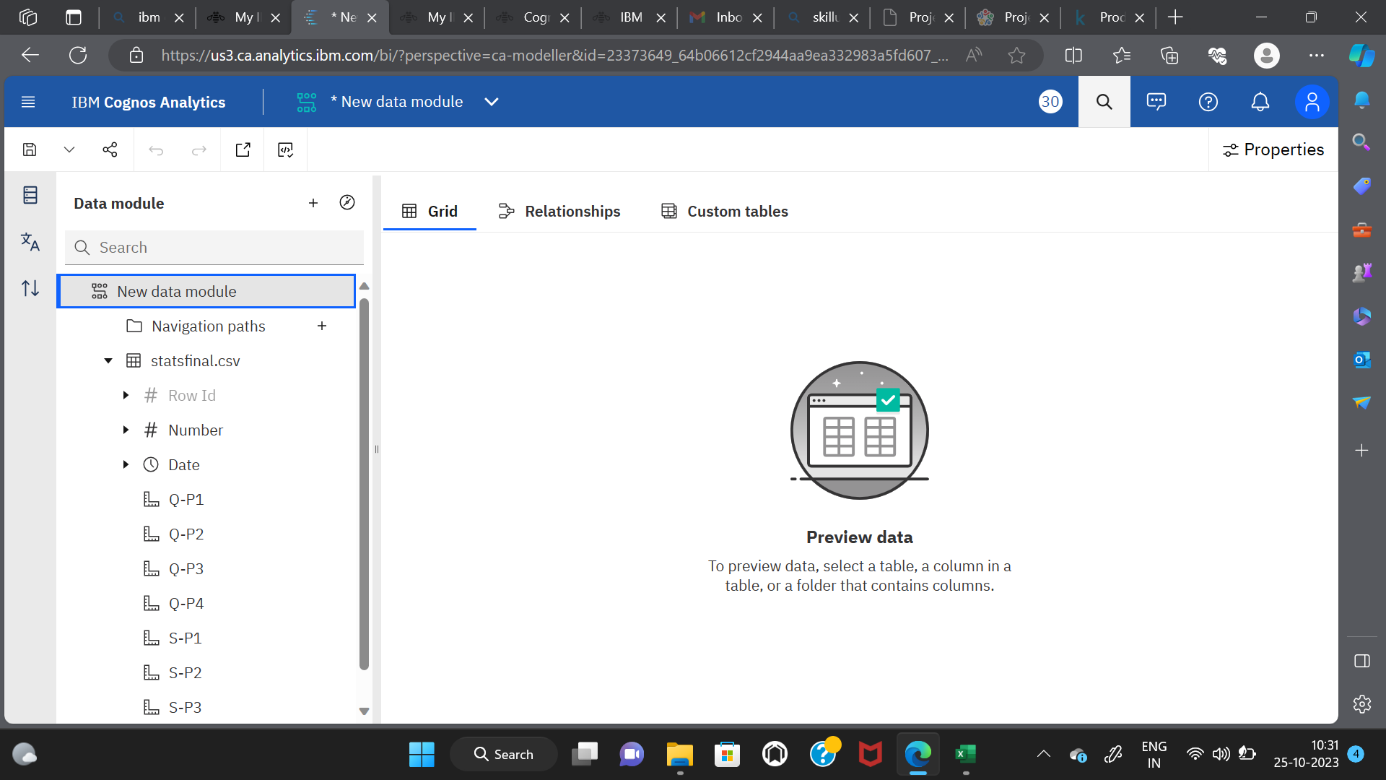
Step-1:Downloading and uploading the dataset
THE FOLLOWING DATASET IS DOWNLOADED AND IT IS SAVED IN FILE MANAGER AND IT IS UPLOADED

Slide 4
Step-2:Data collection and analysis
IN THIS STAGE ,DATA IS COLLECTED AND ANALYSED USING IBM COGNOS ANALYTICS SOFTWARE

Slide 5
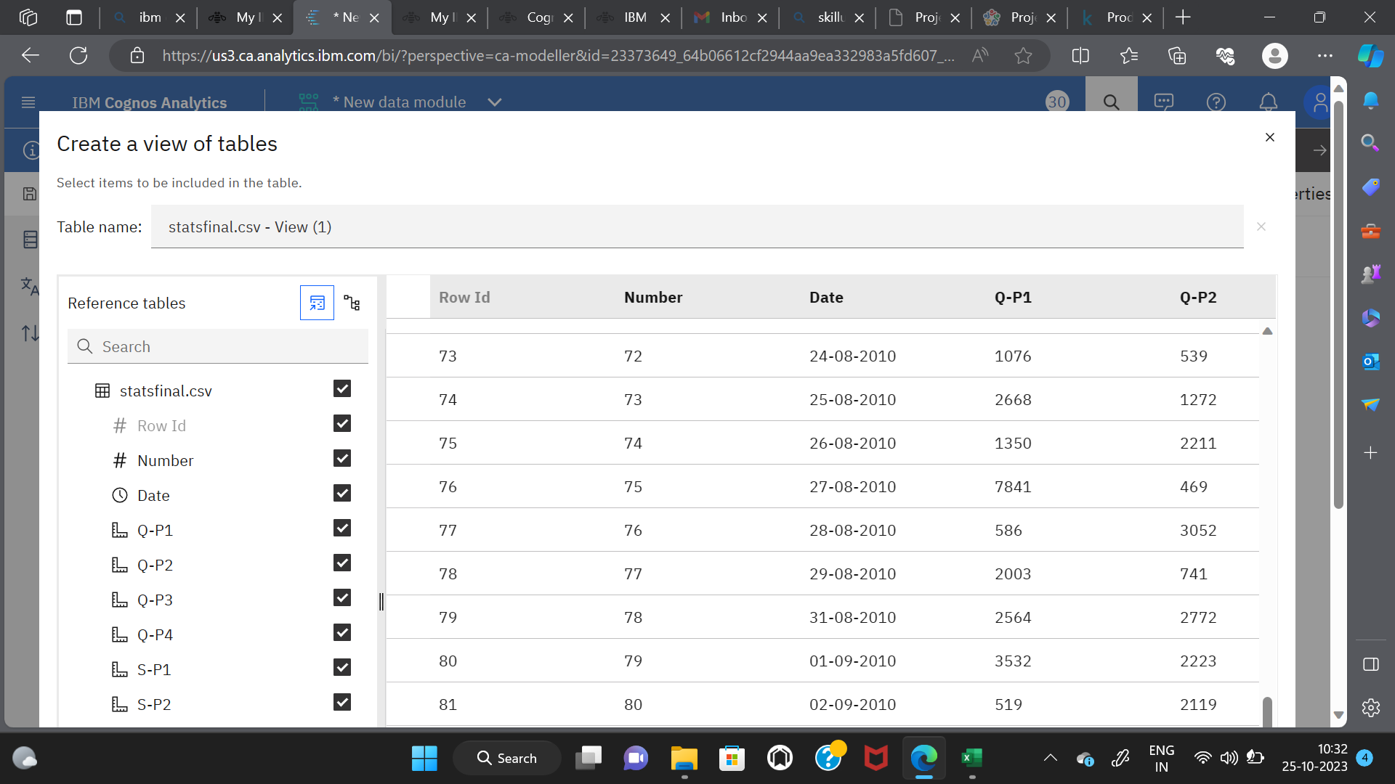
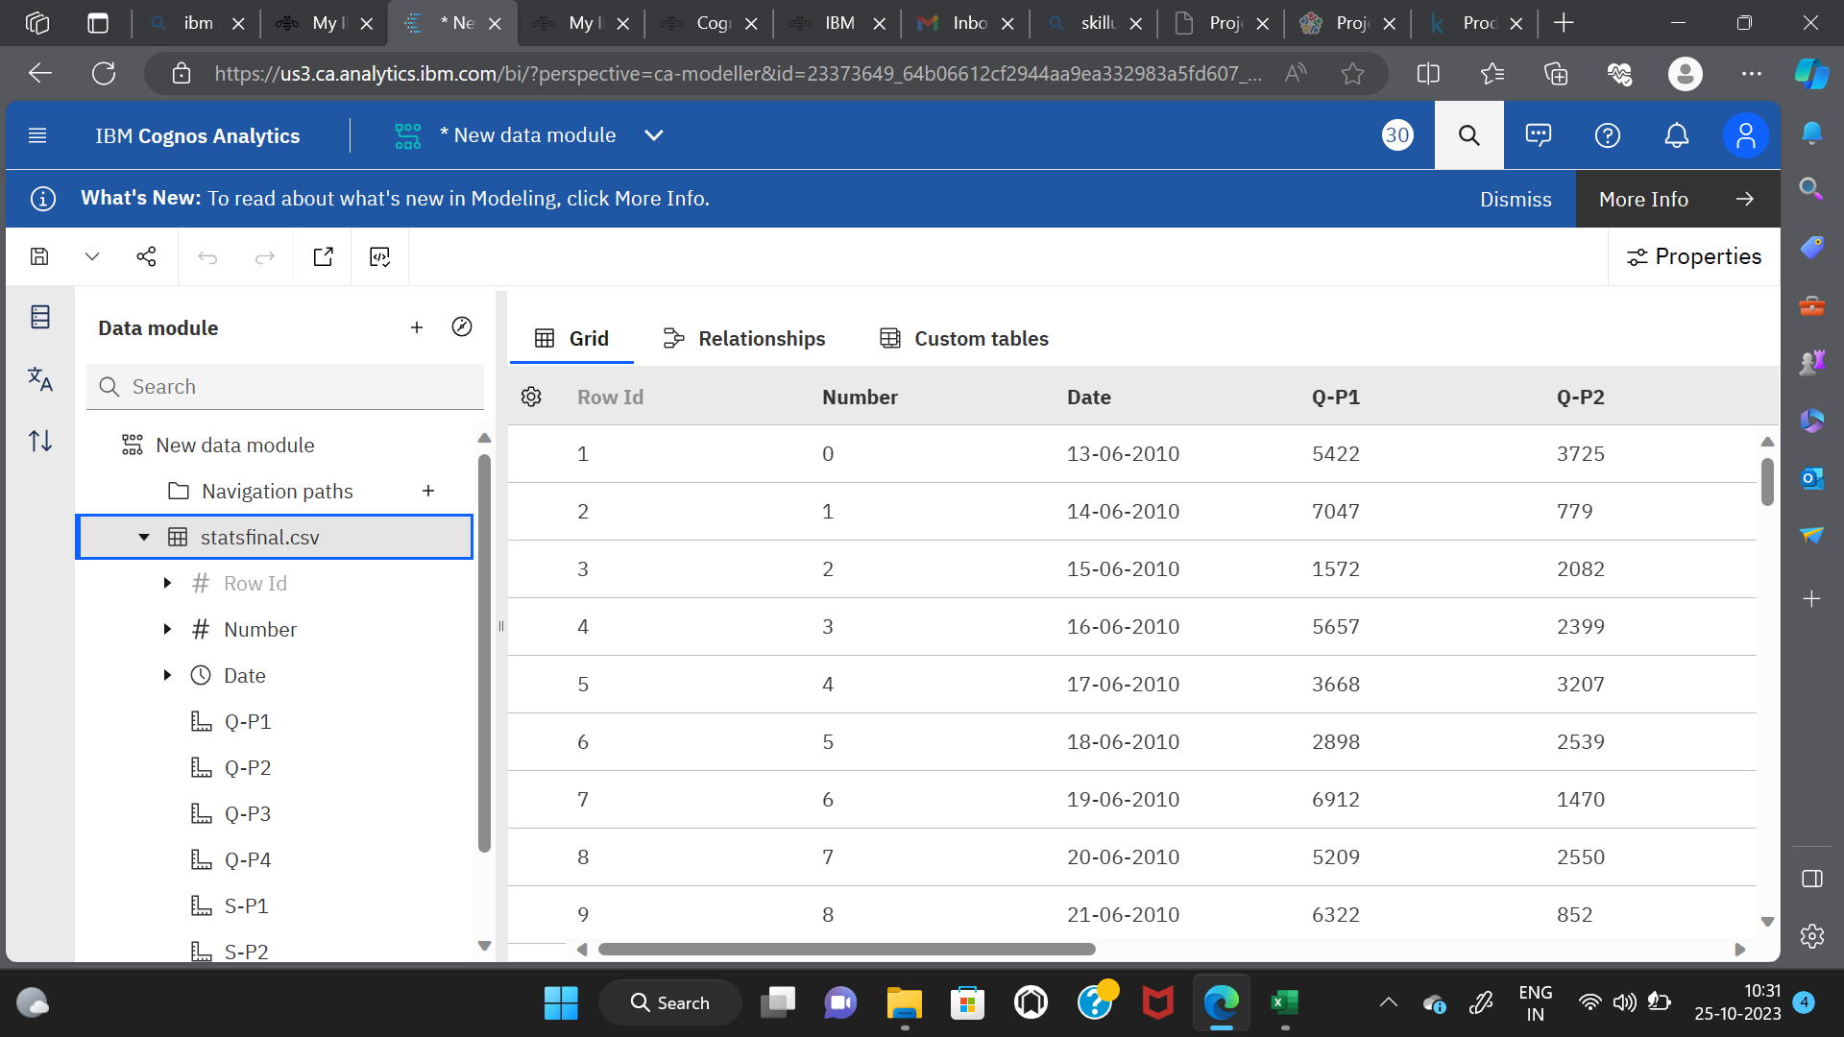

Slide 6
LINE CHART FOR QUANTITY AND SALES OF THE PRODUCT DAY WISE

Slide 7
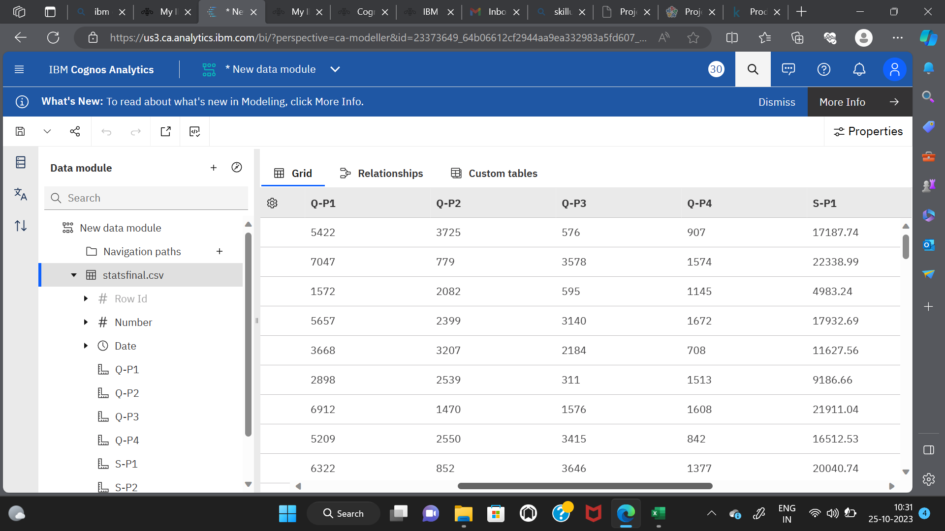

Slide 8
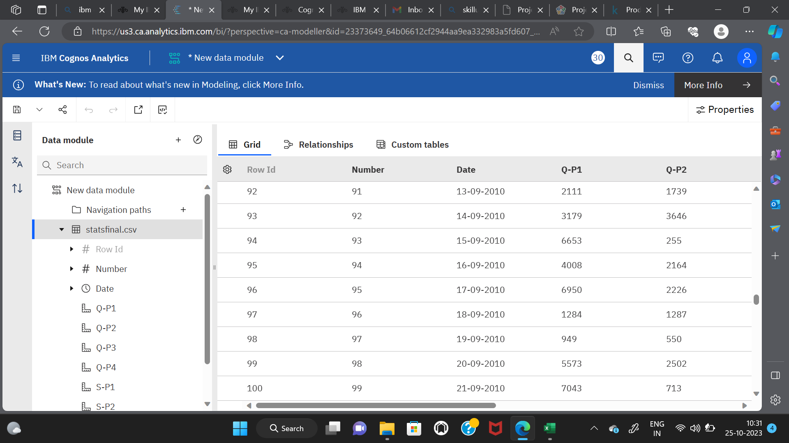

Slide 9
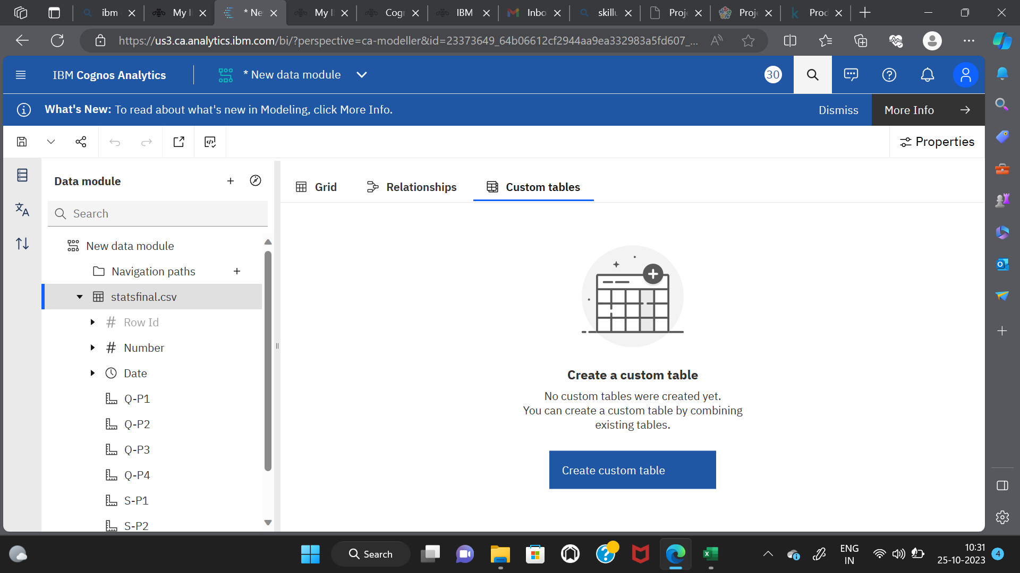
Step-3:Data preprocessing and cleaning

Slide 10
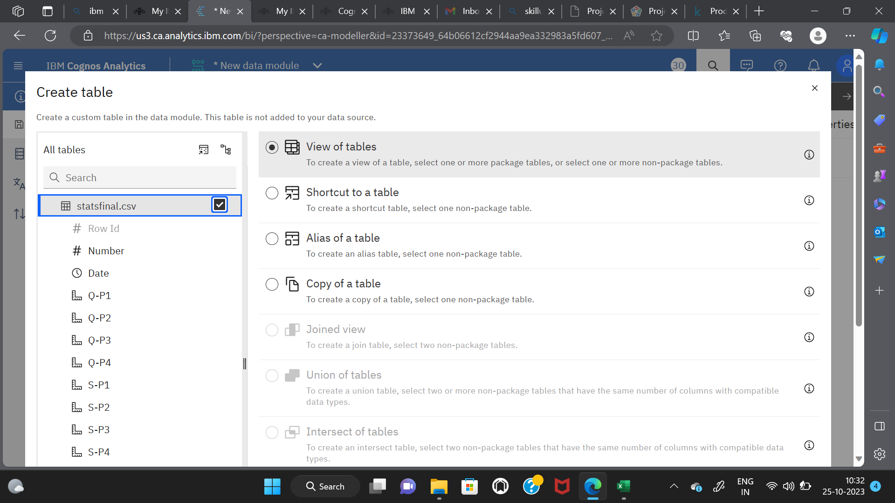

Slide 11


Slide 12
THANK YOU

